Slide 1
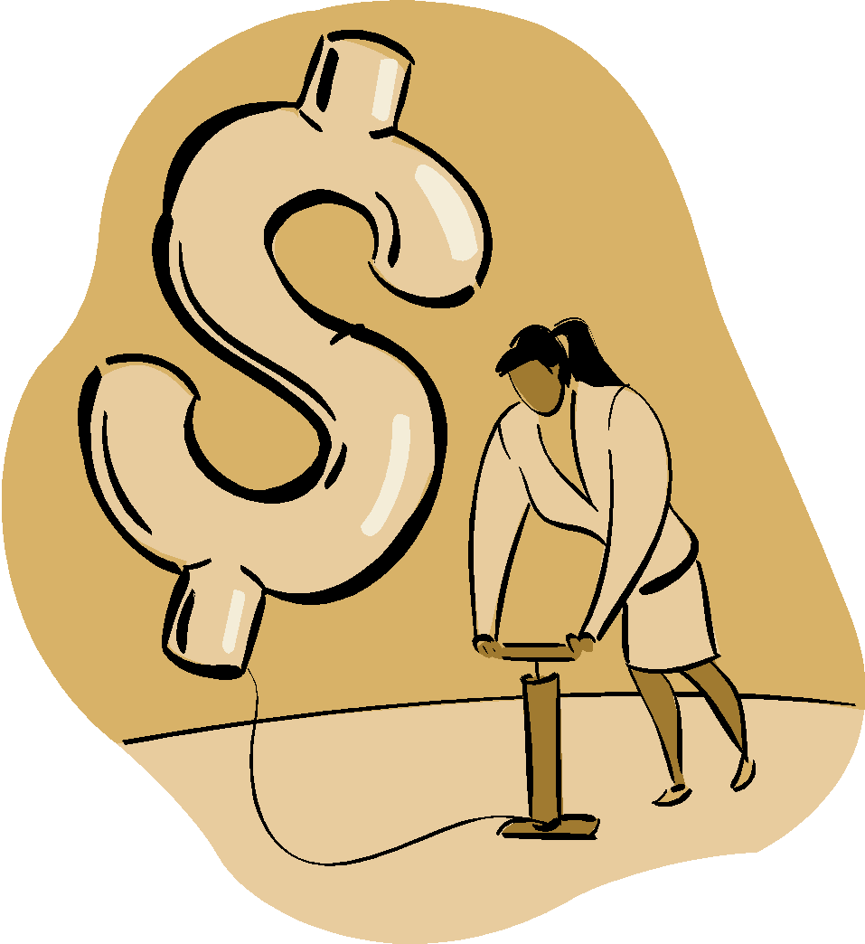
Savings vs. Investing
Notes:
The pyramid shows the risks and rewards of different types of investments.
Investments with lower risks and lower returns are at the bottom of the pyramid – where the large base makes it stable. As you move up the pyramid, returns usually become greater, but so do the risks.
As an investor, you should move up the pyramid only after you have built a strong foundation. And only if you decide that you are comfortable with the idea of risking your money. While higher rates of return at the top are tempting, keep this in mind: there is no guarantee that higher-risk investments will actually give you higher returns.

Slide 2
Savings
Savings is the portion of current income not spent on consumption.
Investments
Investing is the purchase of assets with the goal of increasing future income.

Slide 3
In Other Words…...
Investing is what you do with your savings to try and:
protect the value of your savings over time against the effects of inflation (purchasing power).
increase value of your savings-and acquire greater purchasing power-by earning a return greater than inflation.
save enough, and ear enough, to be able to achieve your goals.

Slide 4
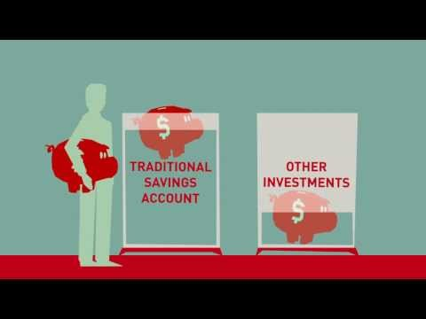

Slide 5
Risk, Return, and Liquidity
Risk
The chance that the value of an investment will decrease.
Return
The profit or yield from an investment.
Liquidity
The ability of an investment to be converted into cash quickly without loss of value.

Slide 6
Risk, Return, and Liquidity
Savings
Low risk
Low return
High liquidity
Investments
High risk
High return
Low liquidity

Slide 7
Inflation, Savings and Investments
Today, a large soft drink at your favorite fast-food place costs $1.00. You buy the soft drink but also decide to save some money for the future as well. So you put a dollar in your savings account, where it earns 5%.
NEFE

Slide 8
Inflation, Savings and Investments
One year later, the dollar in your saving account is worth $1.05. You take the money out and visit your favorite convenience store, hoping to buy another delicious beverage. Unfortunately, drinks now cost $1.10.
NEFE

Slide 9
Inflation, Savings and Investments
The point? Inflation can work against your money. You need to learn to invest wisely, follow the rate of inflation, and make sure your investment rates are higher than those of inflation.

Slide 10
Time Value of Money
The time value of money refers to the fact that a dollar in hand today is worth more than a dollar promised at some future time.

Slide 11
Future Value
Refers to the amount of money to which an investment will grow over a finite period of time at a given interest rate.
Put another way, future value is the cash value of an investment at a particular time in the future.

Slide 12
“You can always make more money, but you can’t make more time.”
Respond to this statement by discussing it with a partner. How does it relate to future value?

Slide 13
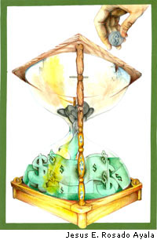
Time Value of Money
Picture from NEFE

Slide 14
Risk and Return
What is the relationship between risk and return?

Slide 15
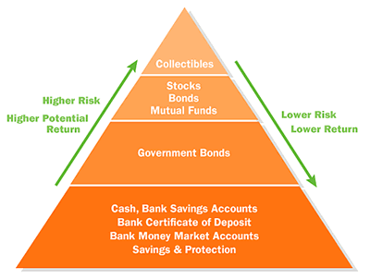

Slide 16
Risk and Return Balance Point
Factors affecting balance point:
Your age
How much you have to invest
your goals and how much you are hoping to earn from your investments in order to realize your goals
Your time horizon-how long before you need to use the money from your investments.

Slide 17
Which financial product is appropriate for the following situations?
Saving for a senior trip
Saving for a down payment on a house
Saving for retirement

Slide 18
Assessment
NEFE Teacher Guide
Notes:
See activity at http://financeintheclassroom.org/downloads/AnalogyLessonPlan.pdf

Slide 19
Sample Student Work
Sample Student Work

Slide 20
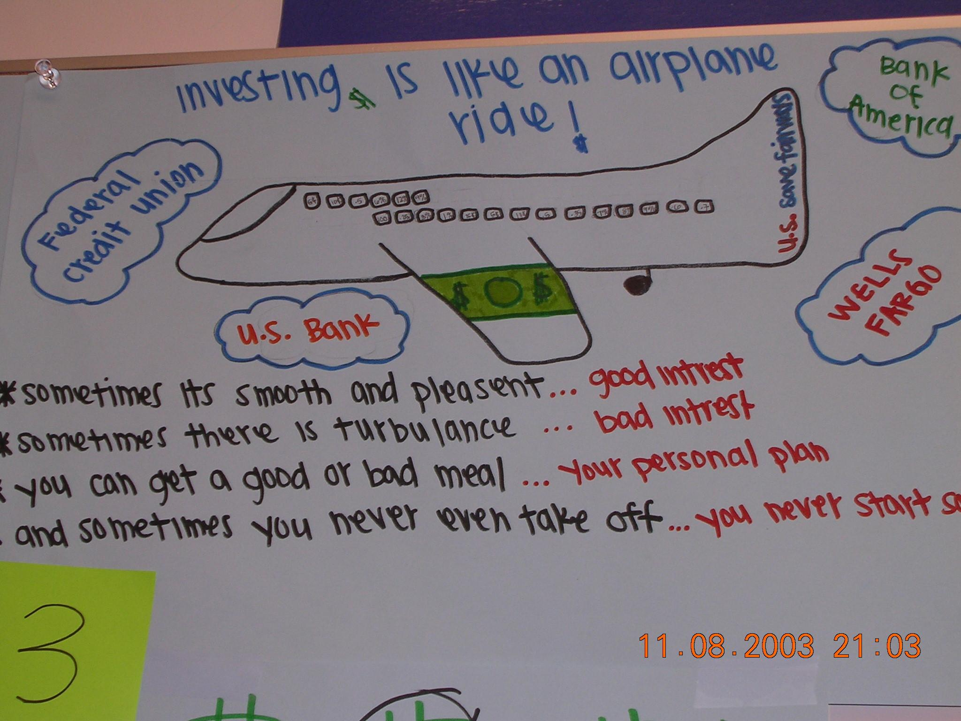
Sample Student Work
Sample Student Work

Slide 21
